Slide 1
3D Game Basic
Class 15
Controlling 3d animations [1]
Handityo aulia putra

Slide 2
Controlling 3D Animations
In this chapter, we will cover:
Configuring a character's Avatar and idle animation
Moving your character with root motion and Blend Trees
Mixing animations with Layers and Masks
Organizing States into Sub-State Machines
Transforming the Character Controller via script
Adding rigid props to animated characters
Using Animation Events to throw an object
Applying Ragdoll physics to a character
Rotating the character's torso to aim a weapon

Slide 3
Controlling 3D Animations
Unity use Mecanim animation system for animating and controlling characters.

Slide 4
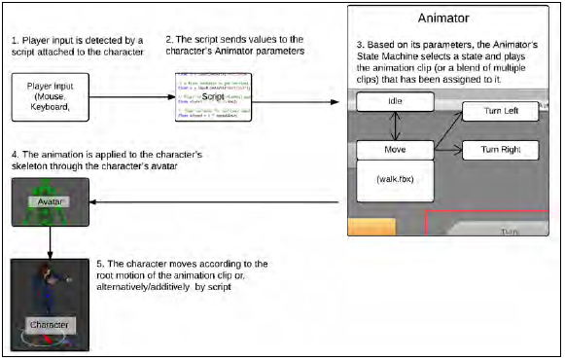
Controlling 3D Animations
ANIMATOR
Player input
Script
Avatar
Character

Slide 5
Controlling 3D Animations
All the projects will make use of Mixamo motion packs.
Mixamo is a complete solution for character production, rigging, and animation.
In fact, the character in use was designed with Mixamo's character creation software called Fuse, and rigged with the Mixamo Auto-rigger.
You can find out more about Mixamo and their products at Unity's Asset Store (https://www.assetstore.unity3d.com/en/#!/publisher/150 ) or their website at https://www.mixamo.com/.
Please note that although Mixamo offers Mecanim-ready characters and animation clips, we will use, for the recipes in this chapter, unprepared animation clips.

Slide 6
MiniProject 15-1: Configuring a character's Avatar and idle animation

Slide 7
Configuring a character's Avatar and idle animation
A feature that makes Mecanim so flexible and powerful is
the ability of quickly reassigning animation clips from one character to another.
This is made possible through the use of Avatars,
which are basically a layer between the character's original rig and the Unity’s Animator system.
In this project, we will learn how to configure an Avatar skeleton on a rigged character.

Slide 8

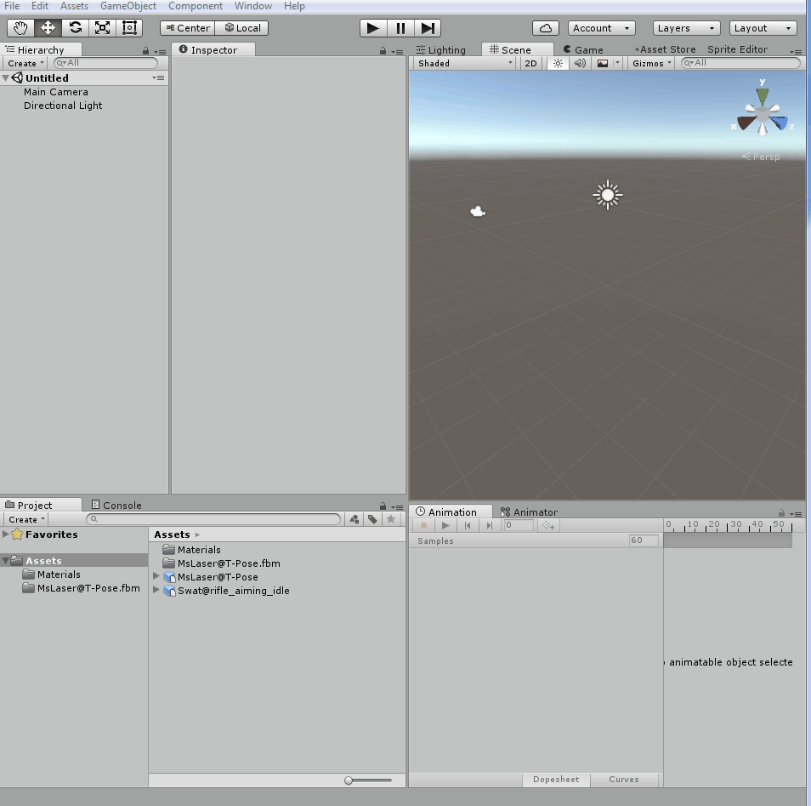
Configuring a character's Avatar and idle animation
1. Import the MsLaser@T-Pose.fbx and Swat@rifle_aiming_idle.fbx prefab files to the project.
2. Select from the Project view,
the MsLaser@T-Pose model.
3. In the Inspector view,
under MsLaser@T-Pose Import Settings, activate the Rig section.
Change Animation Type to Humanoid.
Then, leave Avatar Definition as Create From this Model.
click on Apply
Finally, click on the Configure… button.

Slide 9
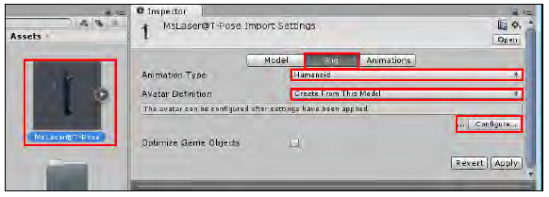

Slide 10
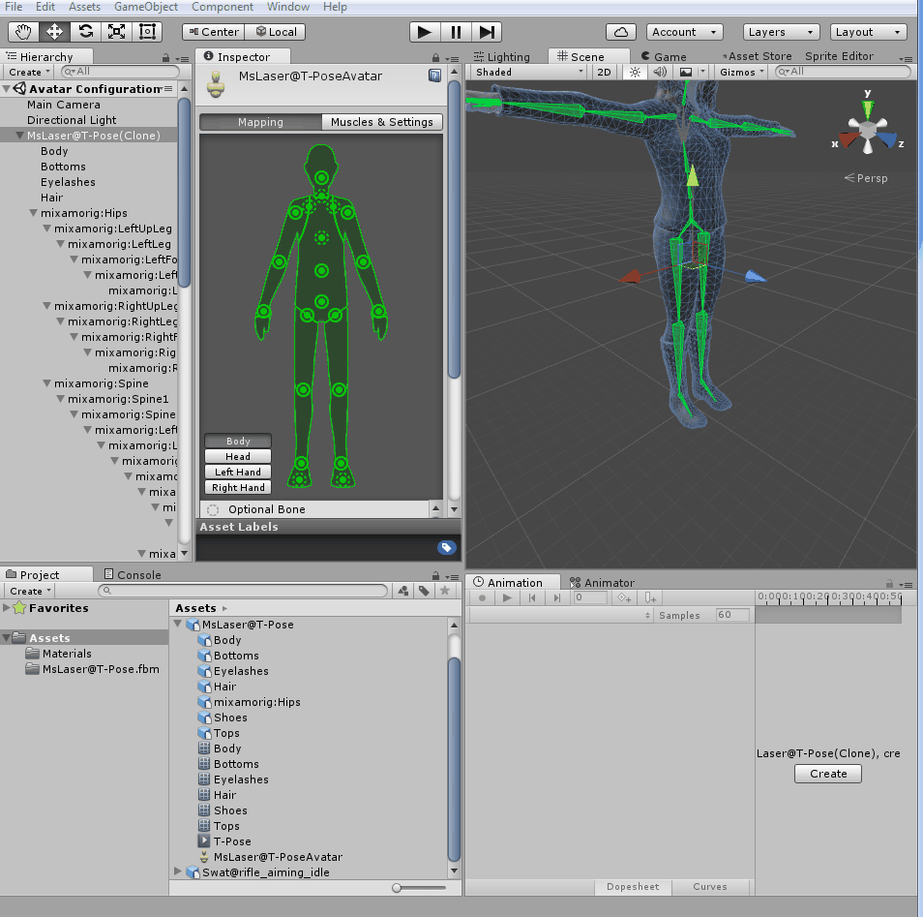
Configuring a character's Avatar and idle animation
4. Inspector view will show the newly created Avatar.
Observe how Unity correctly mapped the bones of our character into its structure, assigning, for instance, the mixamoRig:LeftForeArm bone as the Avatar's Lower Arm.
We could, of course, reassign bones if needed.
For now,
just click on the Done button to close the view.

Slide 11
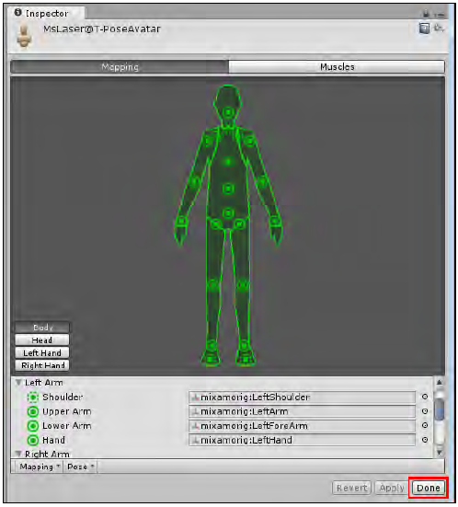

Slide 12
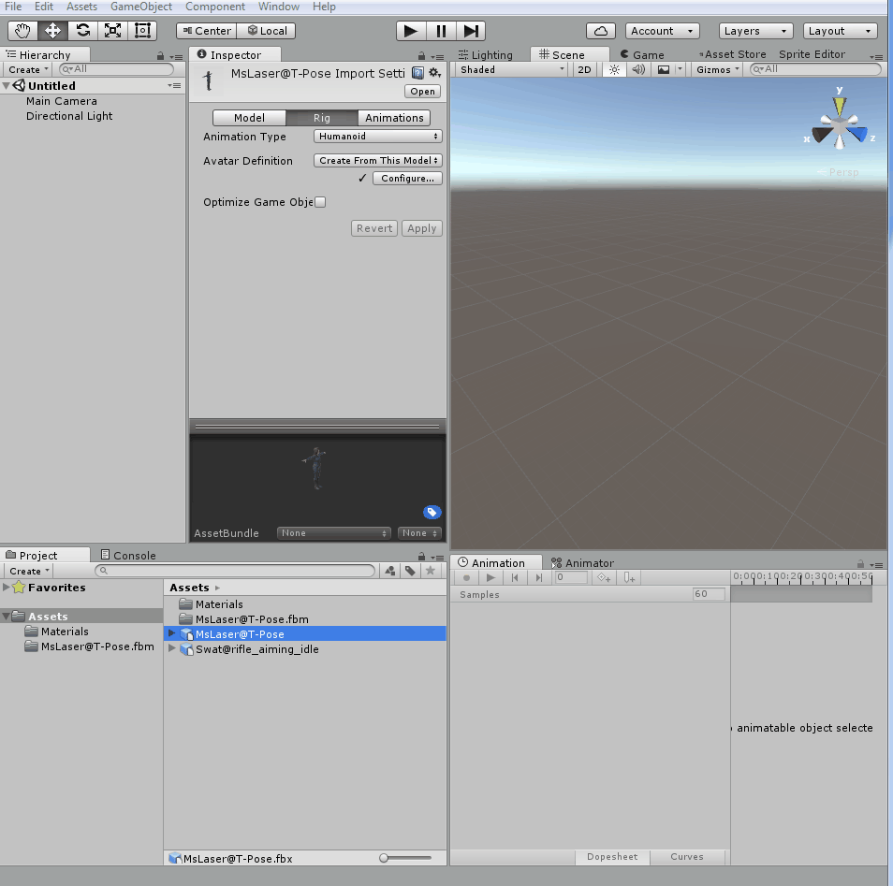
Configuring a character's Avatar and idle animation
5. Now that we have our Avatar ready, let's configure our animation for the Idle state.
From the Project view,
select the Swat@rifle_aiming_idle file.
6. Activate the Rig section,
change
Animation Type to Humanoid and
Avatar Definition to Create From This Model.
Confirm by clicking on Apply.

Slide 13
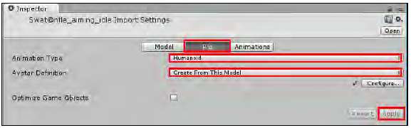

Slide 14
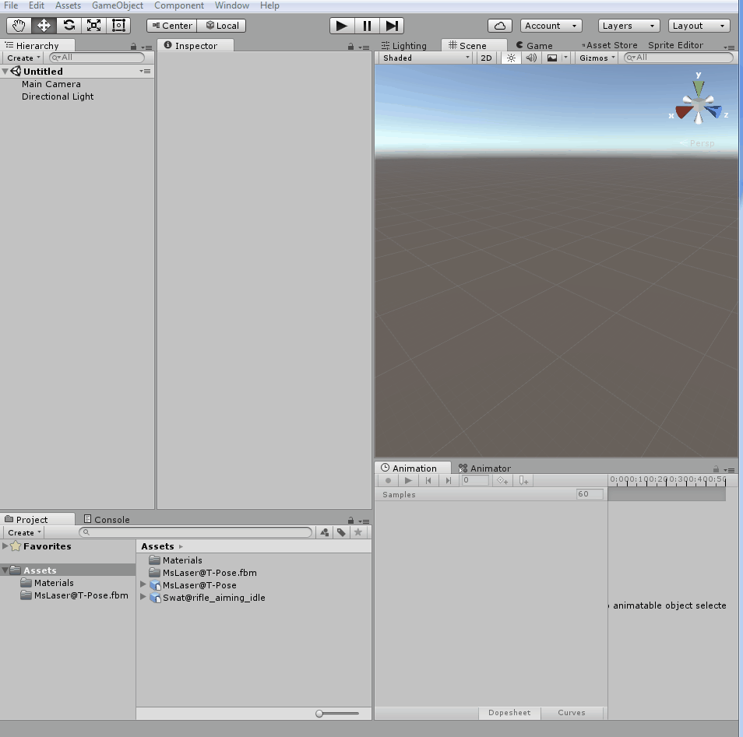
Configuring a character's Avatar and idle animation
7. Activate the Animations section (to the right of the Rig).
Select the rifle_aiming_idle clip
(from the Clips list).
The Preview area
(at the bottom of the Inspector)
will display the message as No model is available for preview.
Please drag a model into this Preview area.
Drag MsLaser@T-Pose to the Preview area to correct this.

Slide 15
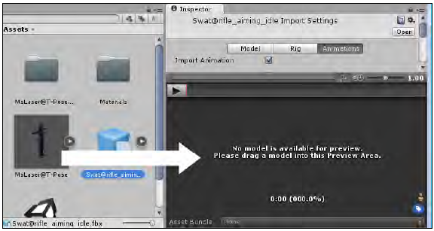

Slide 16
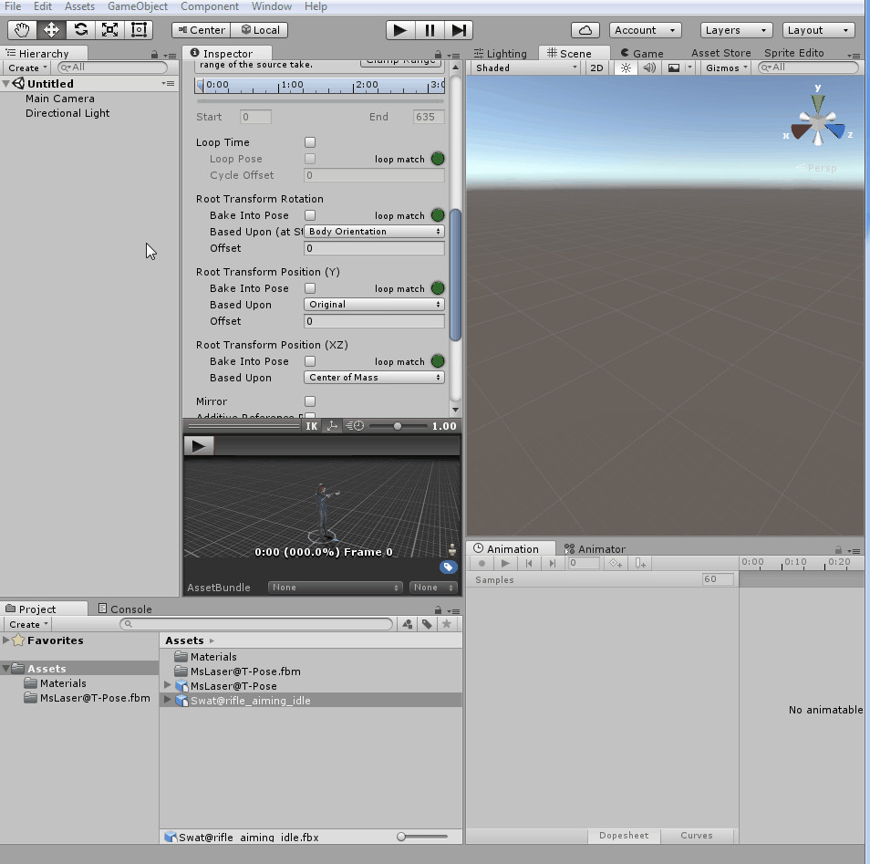
Configuring a character's Avatar and idle animation
8. With rifle_aiming_idle selected from the Clips list, check the Loop Time and Loop Pose options.
Also, click on the Clamp Range button to adjust the timeline to the actual time of the animation clip.
Then, under Root Transform Rotation, check Bake Into Pose, and select Baked Upon | Original.
Under Root Transform Position (Y), check Bake Into Pose, and select Baked upon (at Start) | Original.
Under Root Transform Position (XZ), leave Bake Into Pose unchecked, and select Baked Upon (at Start) | Center of Mass.
Finally, click on Apply to confirm the changes.

Slide 17
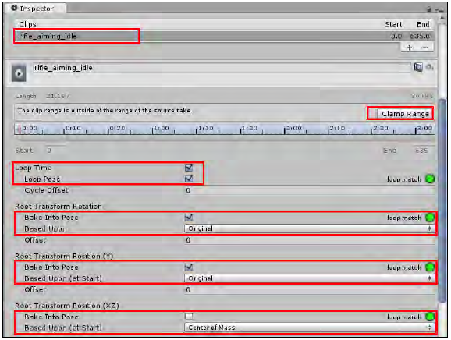

Slide 18
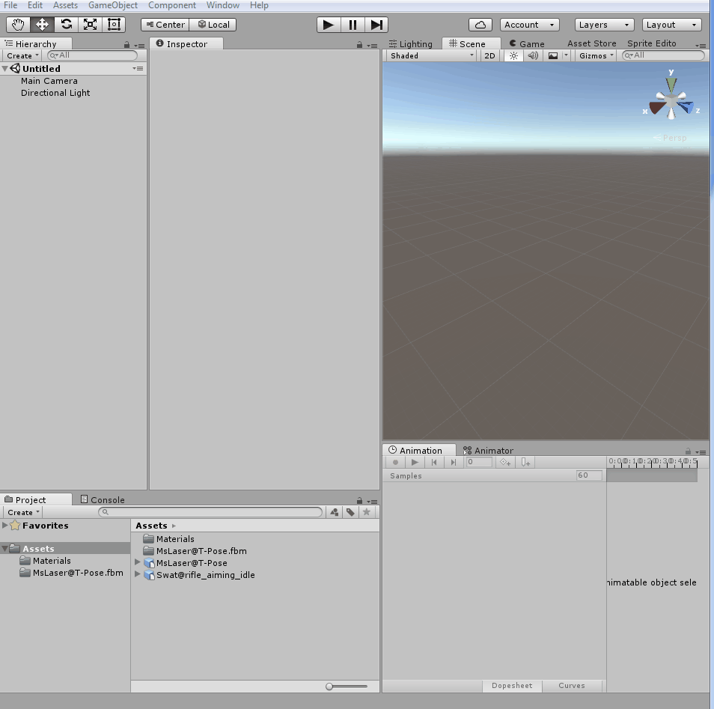
Configuring a character's Avatar and idle animation
9. In order to access animation clips and play them, we need to create a controller.
Do this by clicking on the Create button from the Project view, and then selecting the Animator Controller option.
Name it as MainCharacter.
10. Double-click on the Animator Controller to open the Animator view.

Slide 19
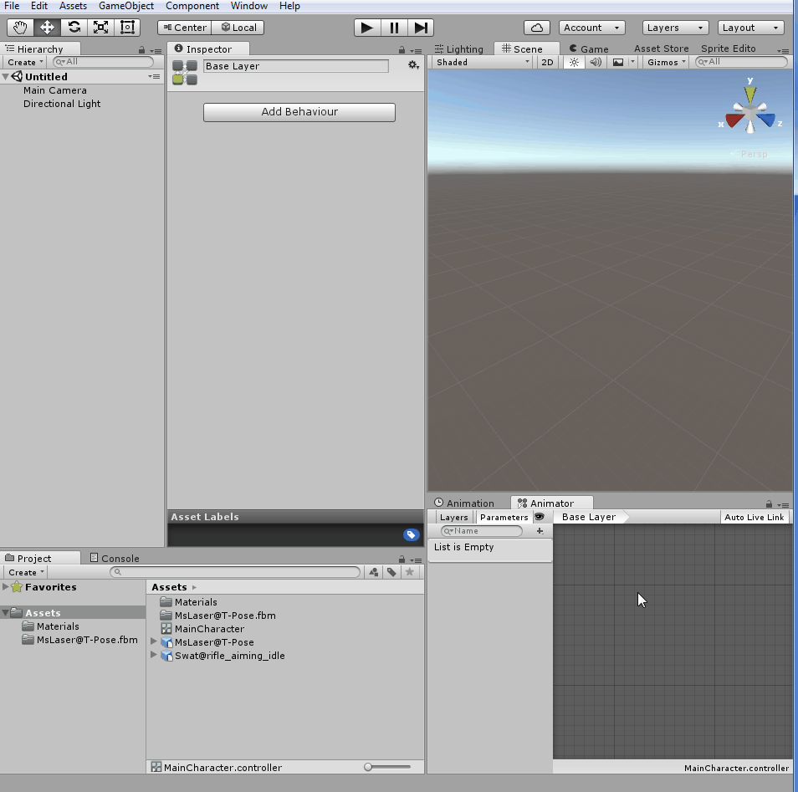
Configuring a character's Avatar and idle animation
11. From the Animator view,
right-click on the grid to open a context menu.
select the Create State | Empty option.
A new box named New State will appear.
It will be in orange, indicating that it is the default state.

Slide 20
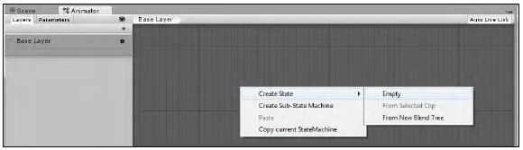

Slide 21
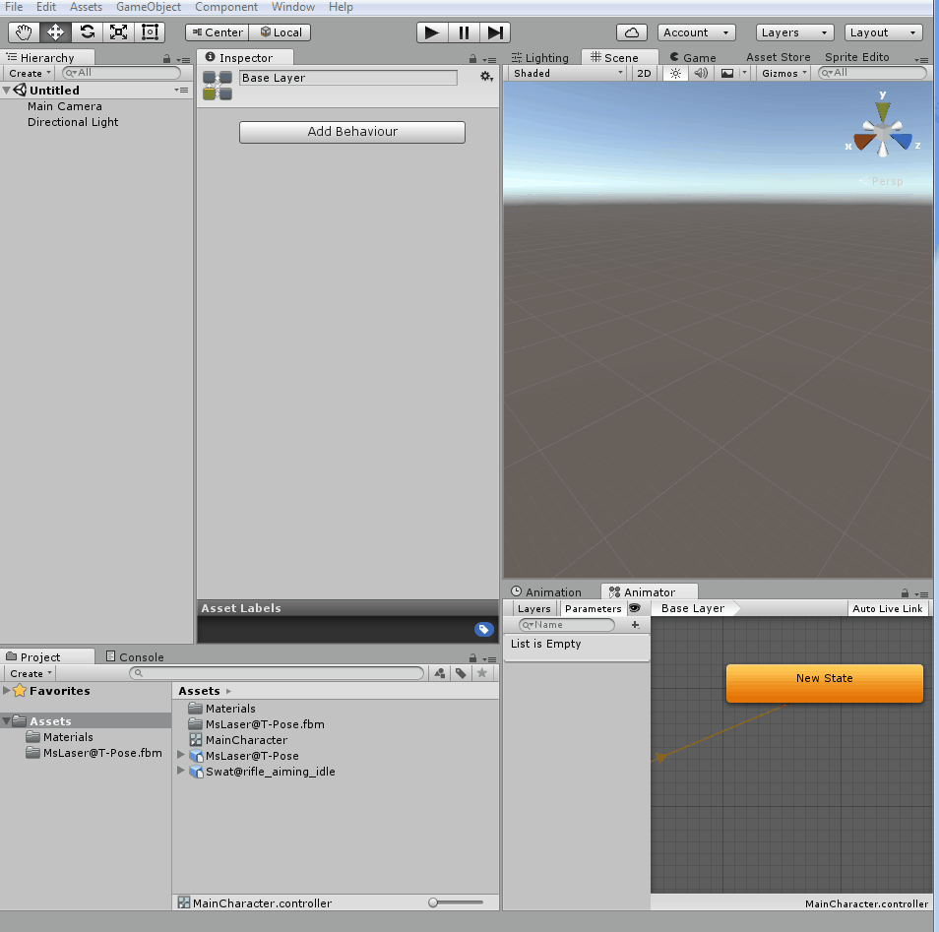
Configuring a character's Avatar and idle animation
12. Select New State and, in the Inspector view,
change its name to Idle.
in the Motion field, choose rifle_aiming_idle by either selecting it from the list or dragging it from the Project view.

Slide 22
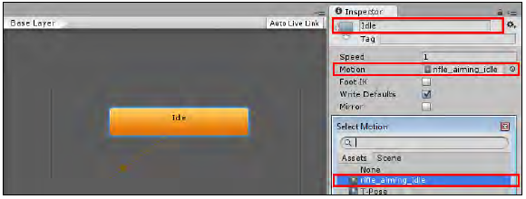

Slide 23
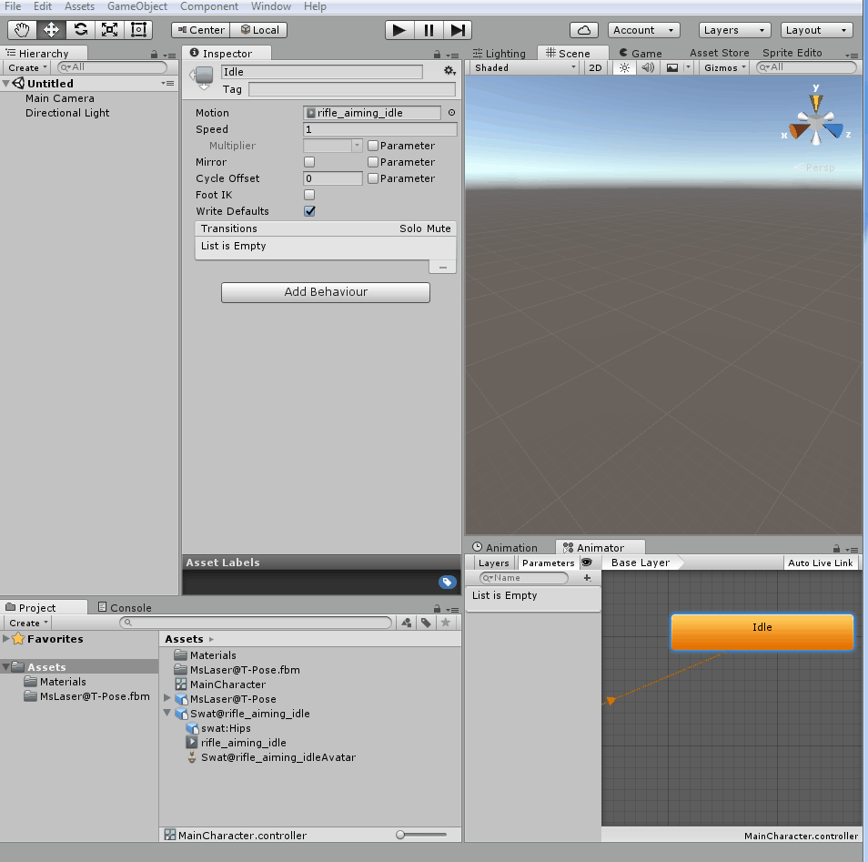
Configuring a character's Avatar and idle animation
13. Drag the MsLaser@T-Pose model from the Project view into the Hierarchy view and place it on the scene.
14. Select MsLaser@T-Pose from the Hierarchy view and observe its Animator component in the Inspector view.
Then, assign the newly created MainCharacter controller to its Controller field.

Slide 24
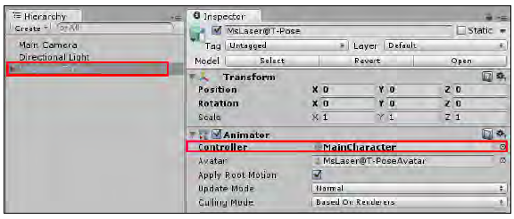

Slide 25
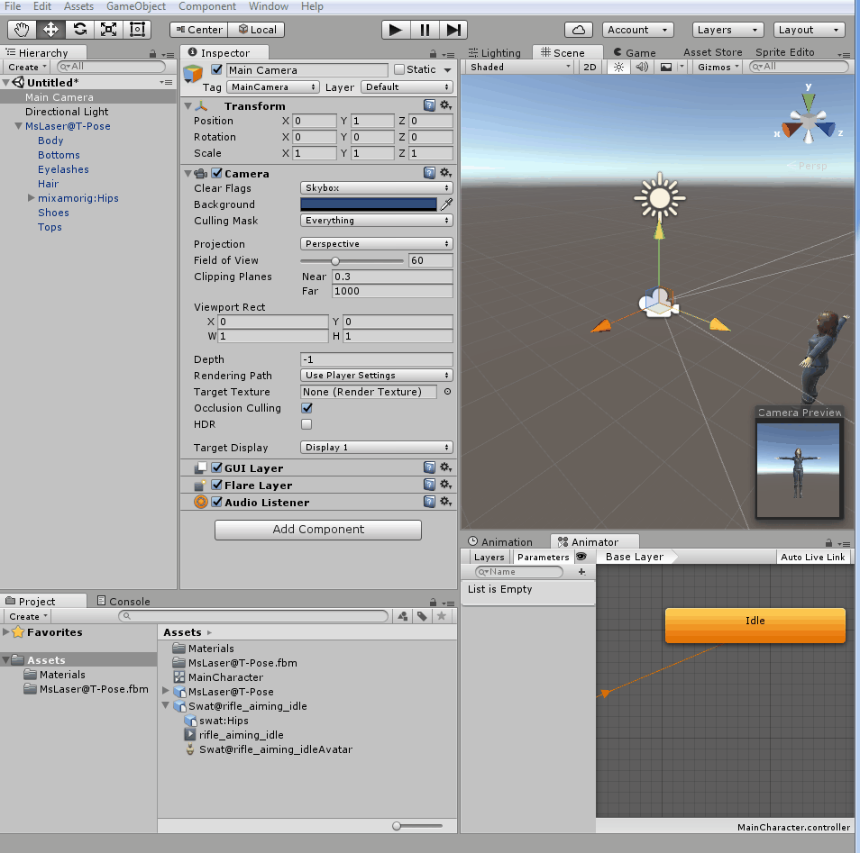
Configuring a character's Avatar and idle animation
15. Play your scene to see the character correctly animated.

Slide 26
MiniProject 15-2: Moving your character with root motion and Blend Trees

Slide 27
Moving your character with root motion and Blend Trees
The Mecanim animation system is capable of applying Root Motion to characters.
In other words,
it actually moves the character according to the animation clip,
as opposed to arbitrarily translating the character model while playing an in-place animation cycle.
This makes most of the Mixamo animation clips perfect for use with Mecanim.

Slide 28
Moving your character with root motion and Blend Trees
Another feature of the animation system is
Blend Trees, which can blend animation clips smoothly and easily.
In this project, we will take advantage of these features to
make our character walk/run forward and backwards, and also strafe right and left at different speeds

Slide 29
Moving your character with root motion and Blend Trees
1. Import
Character_02.unityPackage,
Swat@rifle_run,
Swat@run_backwards,
Swat@strafe,
Swat@strafe_2,
Swat@strafe_left,
Swat@strafe_right,
Swat@walking, and
Swat@walking_backwards .fbx
2. We need to configure our animation clips.
From the Project view, select Swat@rifle_run.
3. Activate the Rig section.
Change Animation Type to Humanoid and Avatar Definition to Create From this Model.
Confirm by clicking on Apply.

Slide 30
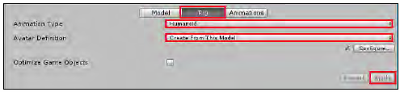
Moving your character with root motion and Blend Trees

Slide 31
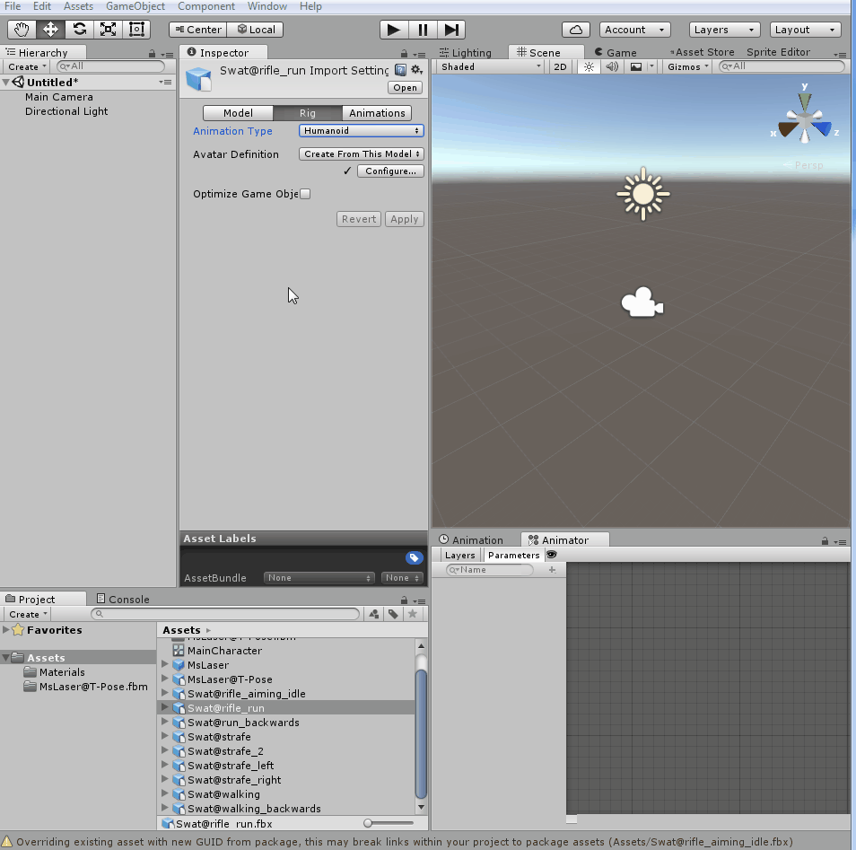
Moving your character with root motion and Blend Trees
4. Now, activate the Animations section (to the right of Rig).
Select the rifle_run clip (from the Clips list).
The Preview area (at the bottom of the Inspector view) will display the message as No model is available for preview.
Please drag a model into this Preview area.
Drag MsLaser@T-Pose onto the Preview area to correct this.

Slide 32
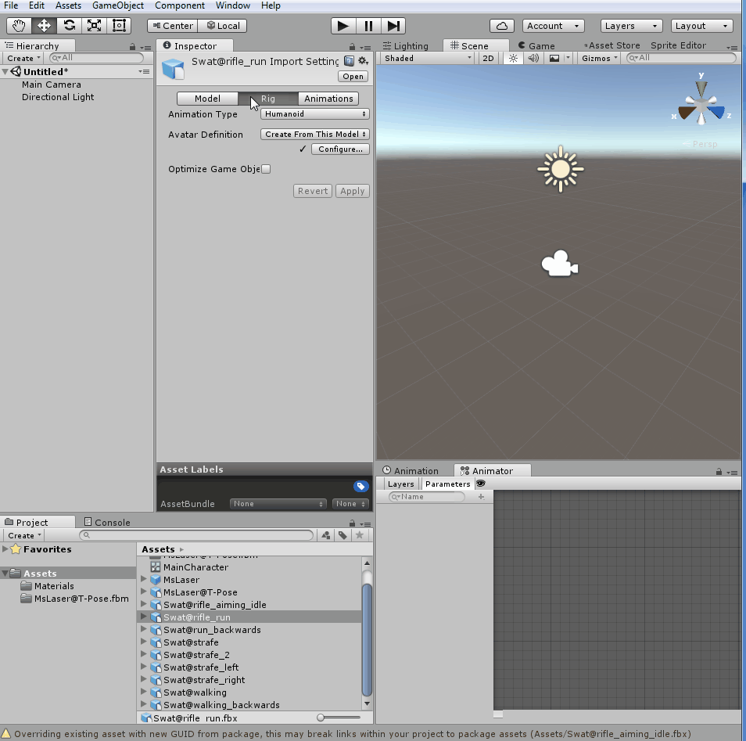
Moving your character with root motion and Blend Trees
5. With rifle_run selected from the Clips list,
select the rifle_run clip (from the Clips list) and
check the Loop Time and Loop Pose options.
Also, click on the Clamp Range button to adjust the timeline to the actual time of the animation clip.

Slide 33
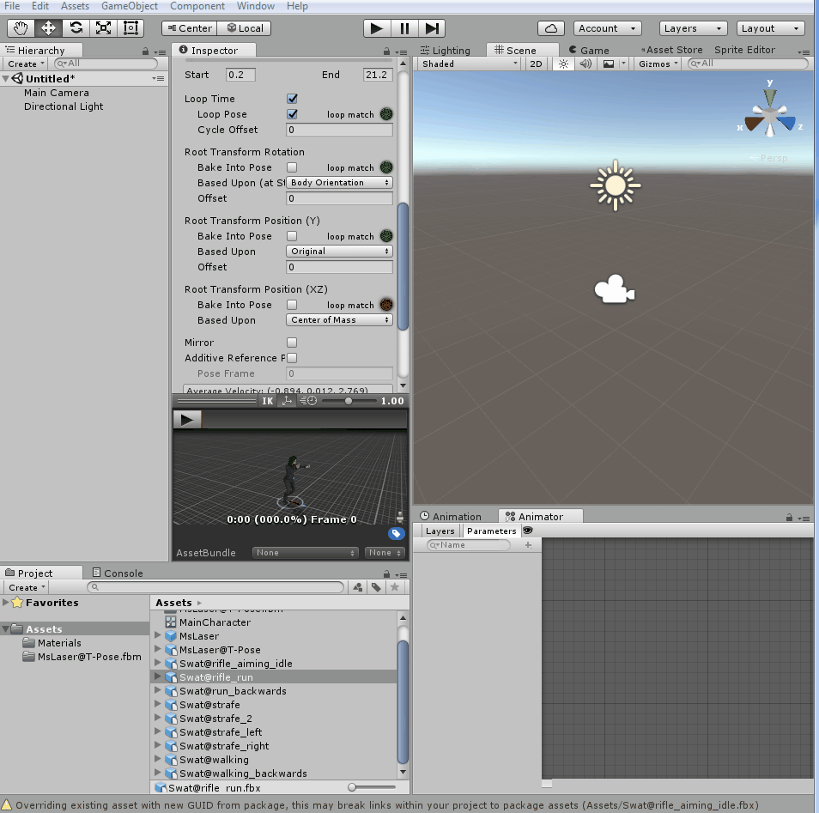
Moving your character with root motion and Blend Trees
6. Then, under Root Transform Rotation,
check Bake Into Pose, and
select Baked Upon (at Start) | Original.
Under Root Transform Position (Y),
check Bake Into Pose, and
select Baked Upon | Original.
Under Root Transform Position (XZ),
leave Bake Into Pose unchecked, and
select Baked Upon (at Start) | Center of Mass.
Finally, click on Apply to confirm the changes.

Slide 34
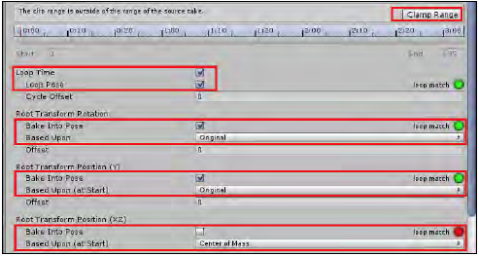
Moving your character with root motion and Blend Trees

Slide 35
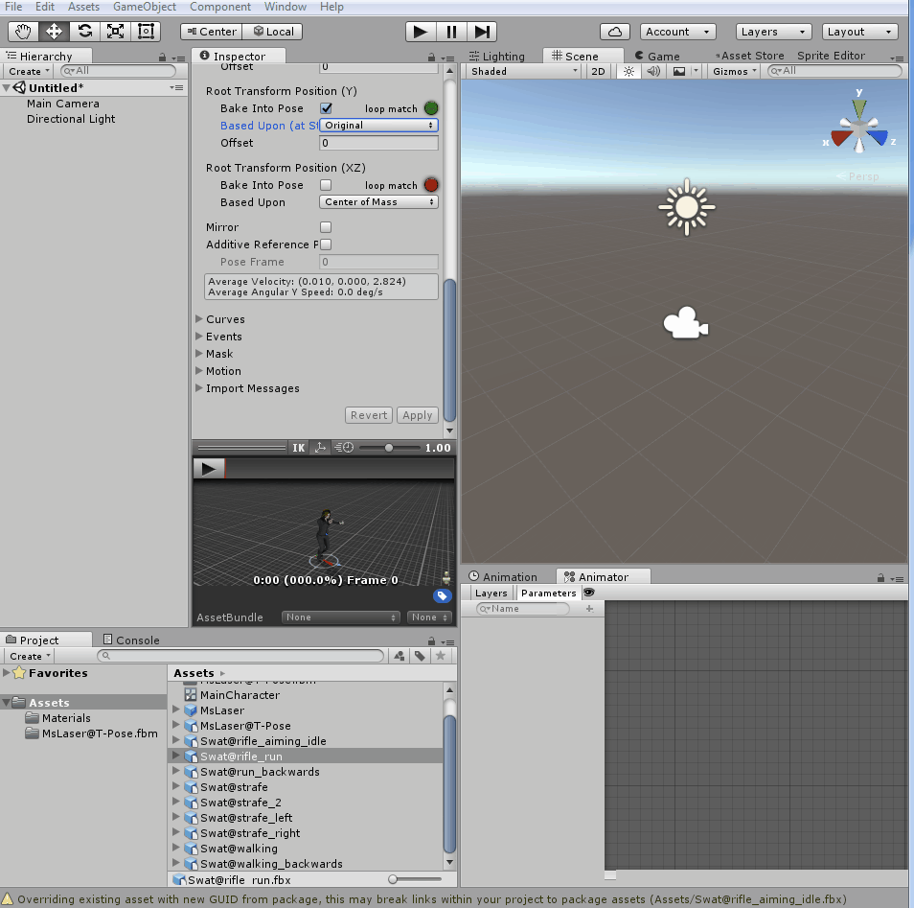
Moving your character with root motion and Blend Trees
7. Repeat steps 3 to 6 for each one of the following animation clips:
Swat@run_backwards,
Swat@strafe,
Swat@strafe_2,
Swat@strafe_left,
Swat@strafe_right,
Swat@walking, and
Swat@walking_backwards.

Slide 36
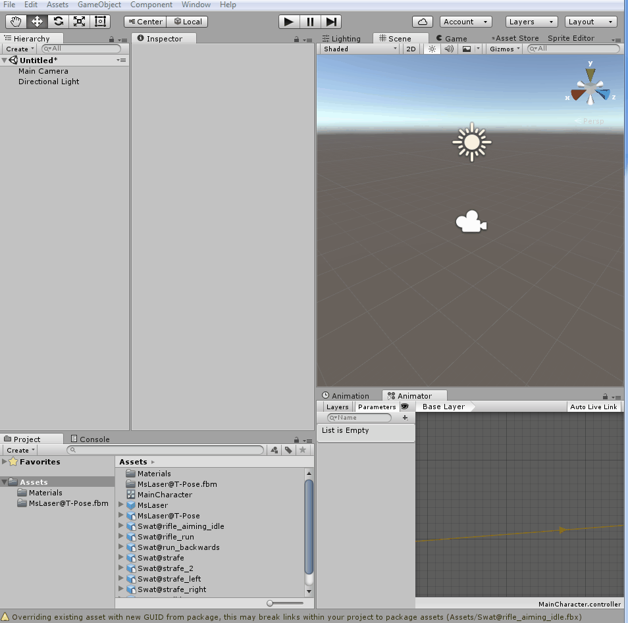
Moving your character with root motion and Blend Trees
8. From the Project view,
select the MsLaser prefab and
drag it onto the Hierarchy view,
placing it on the scene.
9. From the Hierarchy view,
select the MsLaser GameObject
attach a Character Controller component to it (menu Component | Physics | Character Controller).
set its Skin Width as 0.0001,
set Center as X: 0, Y: 0.9, Z: 0;
change its Radius to 0.34
change its Height to 1.79.

Slide 37
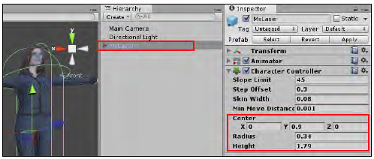
Moving your character with root motion and Blend Trees

Slide 38

Moving your character with root motion and Blend Trees
10. In the Project view,
open the MainCharacter controller.
11. In the top-left corner of the Animator view,
activate the Parameters section
use the + sign to create three new Parameters (Float) named xSpeed, zSpeed, and Speed.

Slide 39
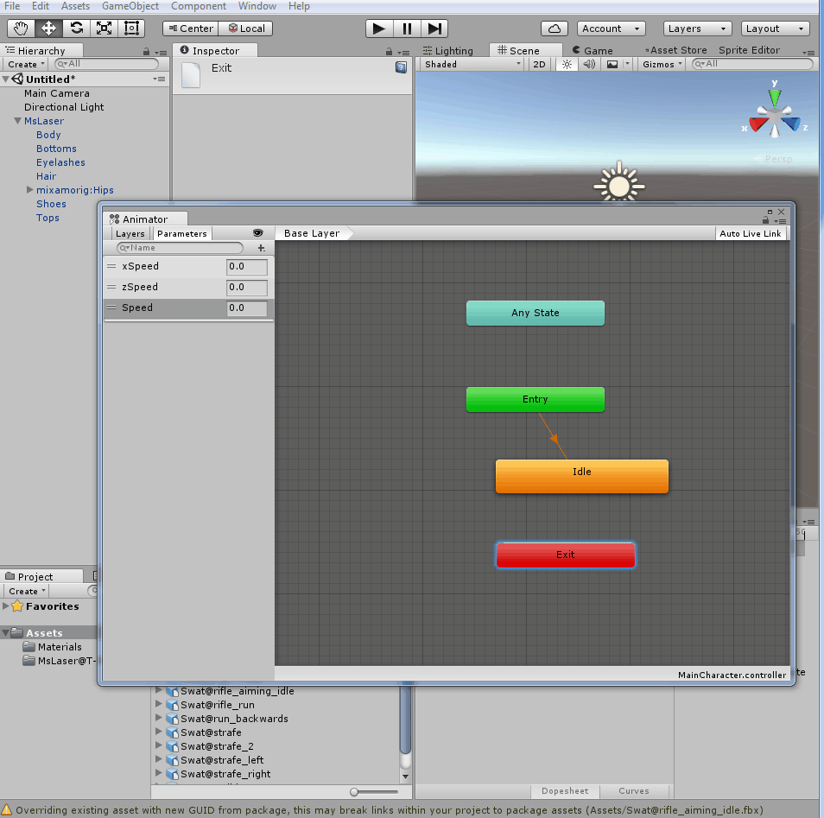
Moving your character with root motion and Blend Trees
12. We do have an Idle state for our character, but we need the new ones.
Right-click on the gridded area and, from the context menu,
navigate to Create State | From New Blend Tree.
Change its name, from the Inspector view, to Move.

Slide 40
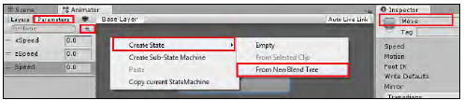
Moving your character with root motion and Blend Trees

Slide 41
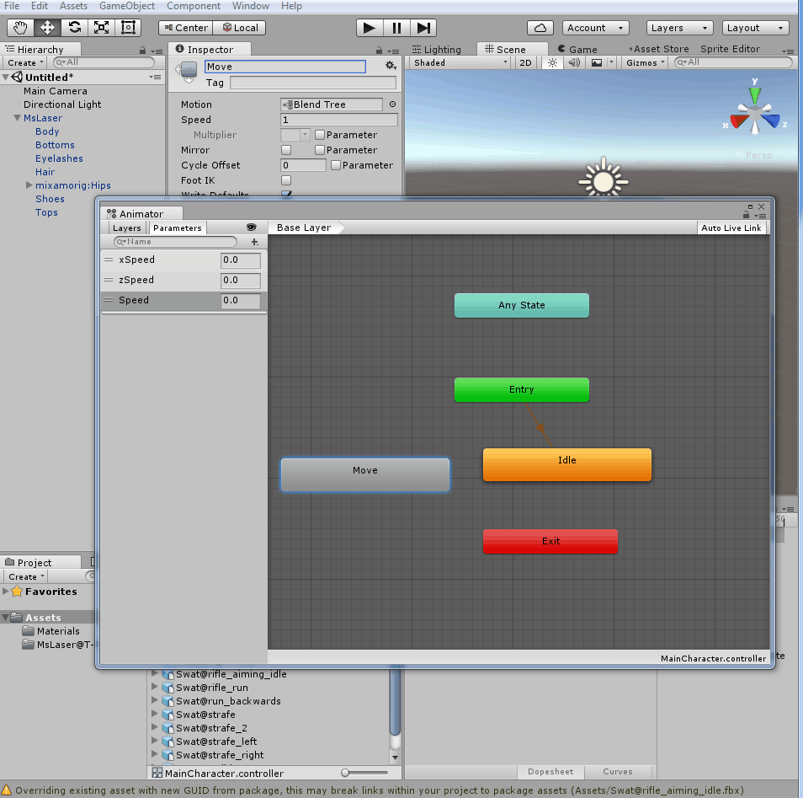
Moving your character with root motion and Blend Trees
13. Double-click on the Move state. You will see the empty blend tree that you have created.
Select the Move state and,
in the Inspector view, rename it to Move.
Then, change its Blend Type to 2D Freeform Directional, also setting xSpeed and zSpeed in the Parameters tab.
Finally, using the + sign from the bottom of the Motion list, add nine new Motion Fields.

Slide 42
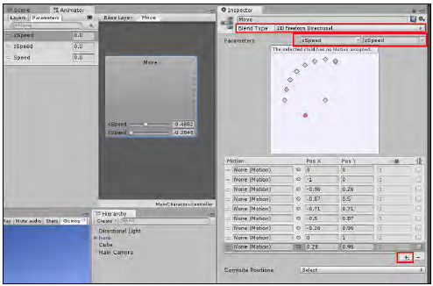
Moving your character with root motion and Blend Trees

Slide 43
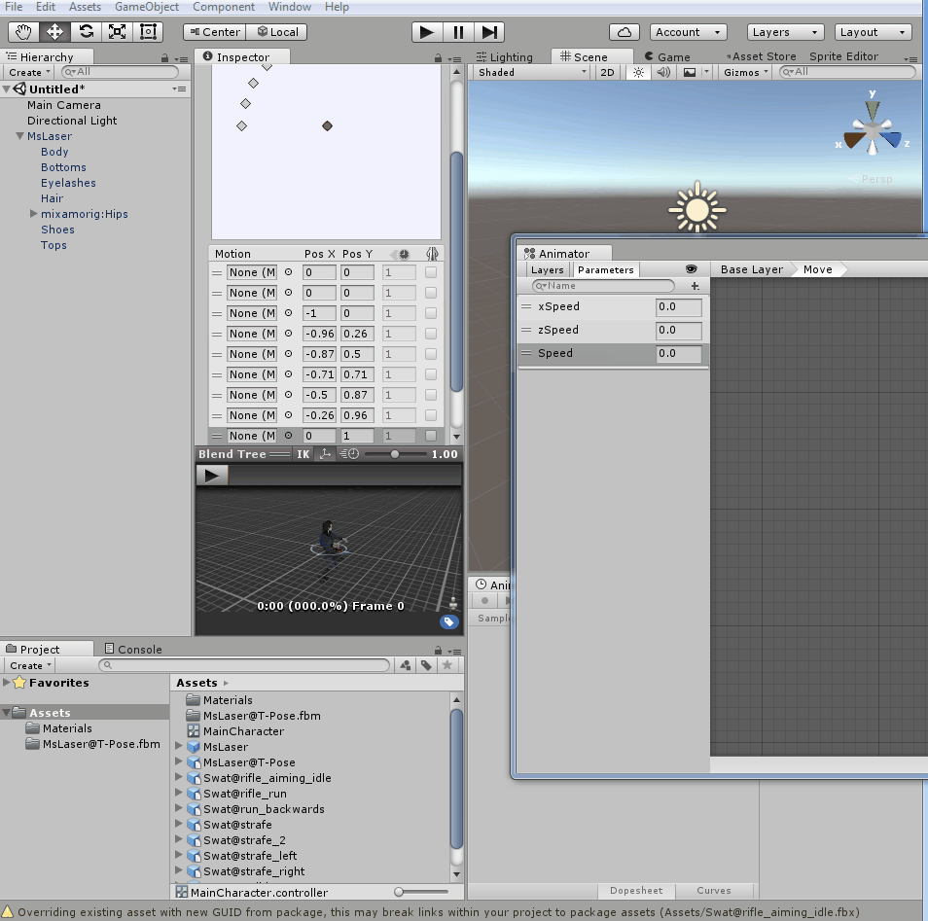
Moving your character with root motion and Blend Trees
14. Now, populate the Motion list with the following motion clips and respective Pos X and Pos Y values:
run_backwards, 0, -1;
walking_backwards, 0, -0.5;
rifle_ aiming_idle, 0, 0;
walking, 0, 0.5;
rifle_run, 0, 1;
strafe, -1, 0;
strafe_left, -0.5, 0;
strafe_right, 0.5, 0;
strafe_2, 1, 0.
You can populate the Motion list by selecting it from the list or, if there are more than one clip with the same name, you can drag it from the Project view onto the slot
(by expanding the appropriate model icon).

Slide 44
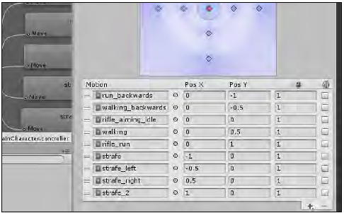
Moving your character with root motion and Blend Trees

Slide 45
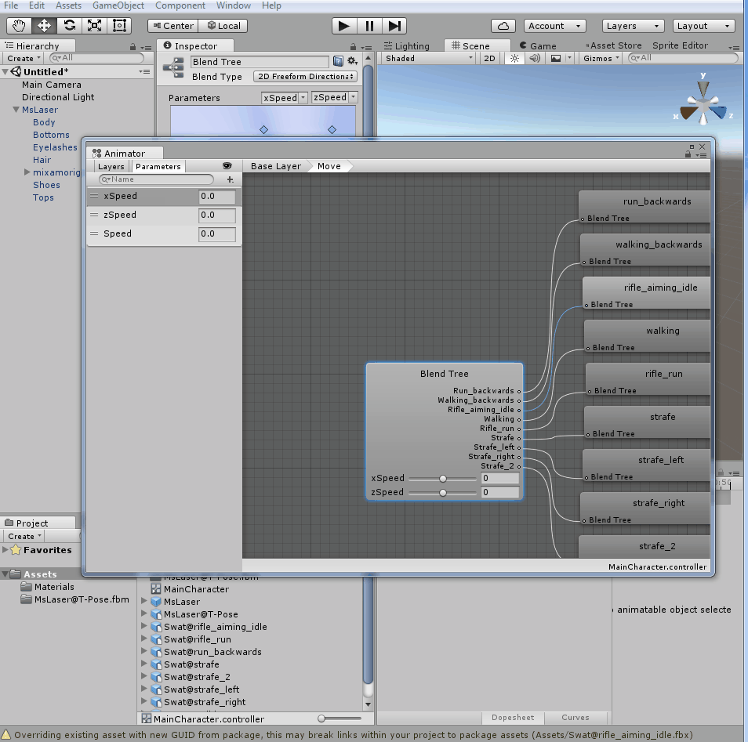
Moving your character with root motion and Blend Trees
15. Double-click on the gridded area to go from the Move blend tree back to the Base Layer.
16. Since we have the rifle_aiming_idle Motion clip within our Move blend tree, we can get rid of the original Idle state.
Right-click on the Idle state box and, from the menu, select Delete.
The Move blend state will become the new default state, turning orange.

Slide 46
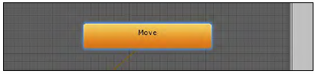
Moving your character with root motion and Blend Trees

Slide 47
Moving your character with root motion and Blend Trees
17. Now, we must create the script that will actually transform the player's input into those variables that are created to control the animation.
18. From the Project view, create a new C# Script and name it as BasicController.
19. Open your script and replace everything with the following code:
using UnityEngine;
using System.Collections;
public class BasicController: MonoBehaviour {
private Animator anim;
private CharacterController controller;
public float transitionTime = .25f;
private float speedLimit = 1.0f;
public bool moveDiagonally = true;
public bool mouseRotate = true;
public bool keyboardRotate = false;
void Start () {
controller = GetComponent<CharacterController>();
anim = GetComponent<Animator>();
}
void Update () {
if(controller.isGrounded){
if (Input.GetKey (KeyCode.RightShift) ||Input.GetKey
(KeyCode.LeftShift))
speedLimit = 0.5f;
else
speedLimit = 1.0f;
float h = Input.GetAxis("Horizontal");
float v = Input.GetAxis("Vertical");
float xSpeed = h * speedLimit;
float zSpeed = v * speedLimit;
float speed = Mathf.Sqrt(h*h+v*v);
if(v!=0 && !moveDiagonally)
xSpeed = 0;
if(v!=0 && keyboardRotate)
this.transform.Rotate(Vector3.up * h, Space.World);
if(mouseRotate)
this.transform.Rotate(Vector3.up * (Input.GetAxis("Mouse
X")) * Mathf.Sign(v), Space.World);
anim.SetFloat("zSpeed", zSpeed, transitionTime, Time.
deltaTime);
anim.SetFloat("xSpeed", xSpeed, transitionTime, Time.
deltaTime);
anim.SetFloat("Speed", speed, transitionTime, Time.
deltaTime);
}
}
}

Slide 48
Moving your character with root motion and Blend Trees
20. Save your script and attach it to the MsLaser GameObject in the Hierarchy view.
Then, add Plane (menu option GameObject | 3D Object | Plane) and
place it beneath the character.
21. Play your scene and test the game.
You will be able to control your character with the arrow keys (or WASD keys).
Keeping the Shift key pressed will slow it down.

Slide 49
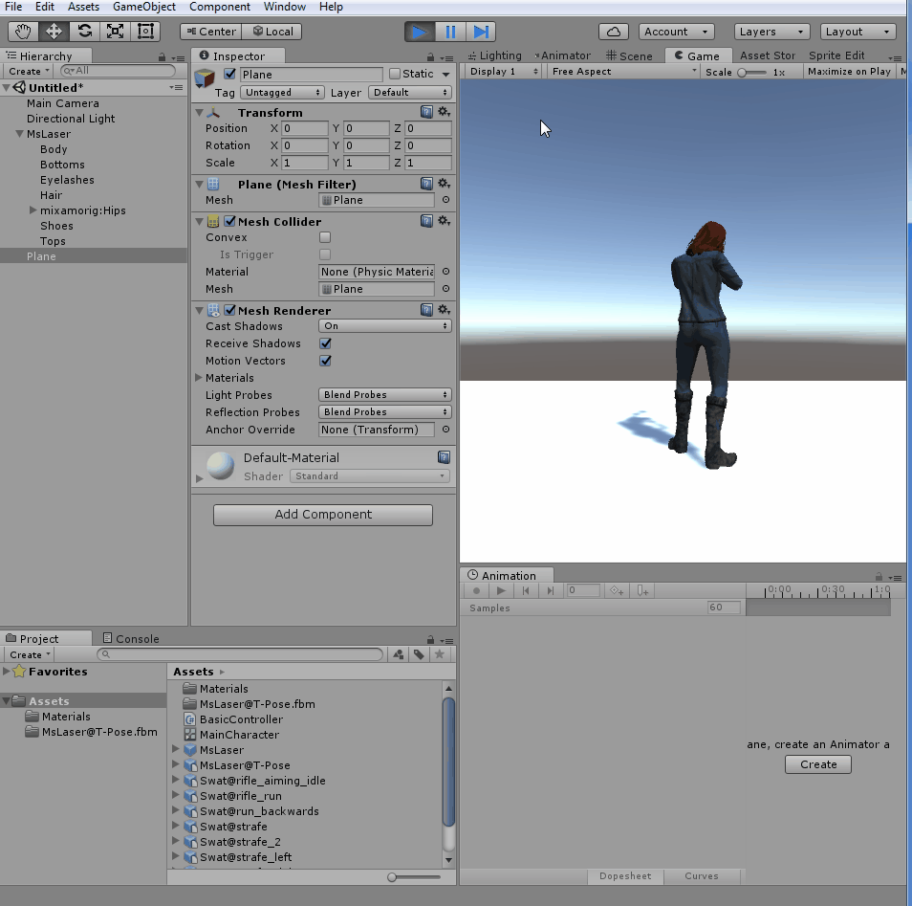
Moving your character with root motion and Blend Trees

Slide 50
Moving your character with root motion and Blend Trees
How it works...

Slide 51
Moving your character with root motion and Blend Trees
Whenever the BasicController script detects any directional keys in use,
it sets the Speed variable of the Animator state to a value higher than 0,
changing the Animator state from Idle to Move.
The Move state, in its turn,
blends the motion clips that it was populated with,
according to the input values for xSpeed (obtained from Horizontal Axis input, typically A and D keys) and
zSpeed (obtained from Vertical Axis input, typically W and S keys).
Since Mecanim is capable of applying root motion to the characters, our character will actually move in the resulting direction.

Slide 52
Moving your character with root motion and Blend Trees
For instance, if W and D keys are pressed,
xSpeed and zSpeed values will rise to 1.0.
From the Inspector view,
it is possible to see that such combination will result in a blend between the motion clips called rifle_run and strafe_2, making the character run diagonally (front + right).

Slide 53
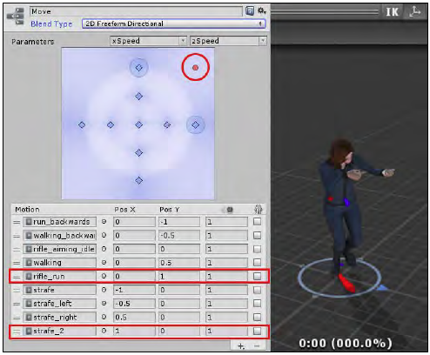
Moving your character with root motion and Blend Trees

Slide 54
Moving your character with root motion and Blend Trees
The BasicController includes three checkboxes for more options:
Move Diagonally—set as true, by default,
which allows for blends between forward/backward and left/right clips;
Mouse Rotate—set as true, by default,
which allows for rotating the character with the mouse, changing their direction while moving;
Keyboard Rotate—set as false, by default,
which allows for rotating the character through simultaneous use of left/right and forward/backwards directional keys.

Slide 55
MiniProject 15-3: Mixing animations with Layers and Masks

Slide 56
Mixing animations with Layers and Masks
Mixing animations is a great way of adding complexity to your animated characters without requiring a vast number of animated clips.
Using Layers and Masks, we can combine different animations by playing specific clips for the specific body parts of the character.
In this project, we will apply this technique to our animated character, triggering animation clips for firing a rifle, and throwing a grenade with the character's upper body.
We will do this while keeping the lower body moving or idle, according to the player's input.

Slide 57
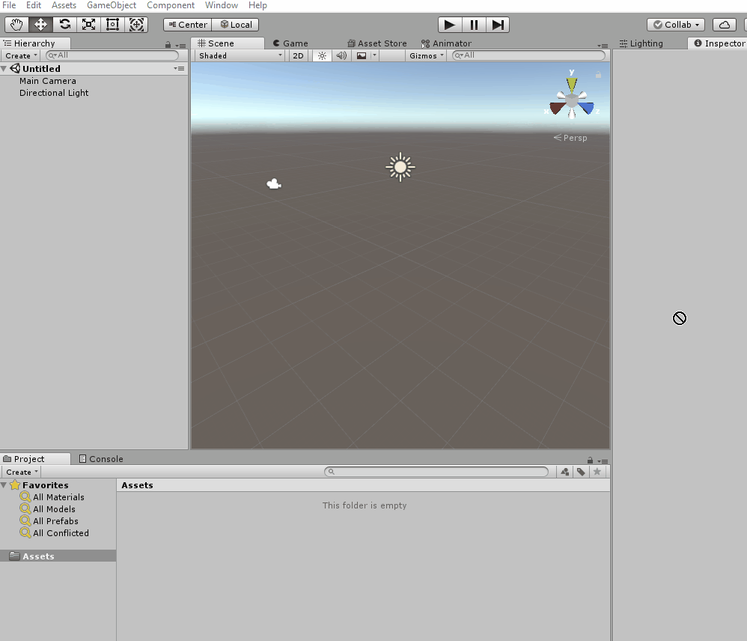
Mixing animations with Layers and Masks
1. Create a new project and import the Mixing Unity Package.
Then, from the Project view,
open the mecanimPlayground level.
2. Import the Swat@firing_rifle.fbx and Swat@toss_grenade.fbx files to the project.

Slide 58
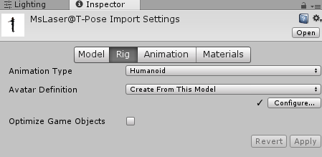
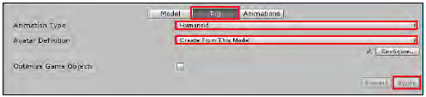
Mixing animations with Layers and Masks
3. We need to configure the animation clips.
From the Project view,
select the Swat@firing_rifle animation clip.
4. Activate the Rig section.
Change Animation Type to Humanoid, and Avatar Definition to Create From this Model.
Confirm this by clicking on Apply.

Slide 59
Mixing animations with Layers and Masks
5. Now, activate the Animations section.
Select the firing_rifle clip (from the Clips list),
click on the Clamp Range button to adjust the timeline, and
check the Loop Time and Loop Pose options.
Under Root Transform Rotation,
check Bake Into Pose, and
select Baked Upon | Original.
Under Root Transform Position (Y),
check Bake Into Pose, and
select Baked Upon (at Start) | Original.
Under Root Transform Position (XZ),
leave Bake Into Pose unchecked.
Click on Apply to confirm the changes.

Slide 60
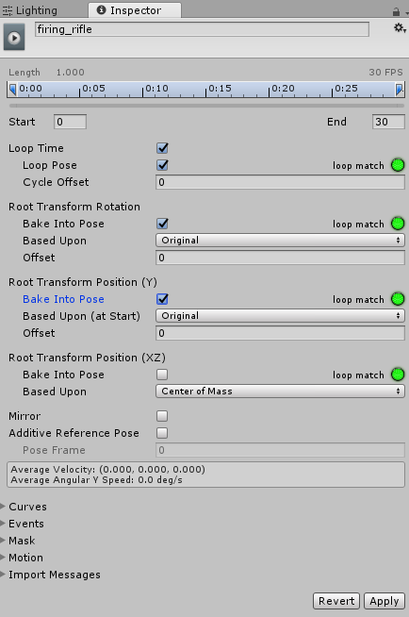
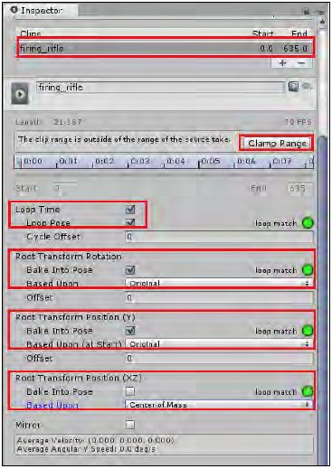

Slide 61
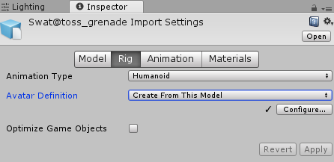
Mixing animations with Layers and Masks
6. Select the Swat@toss_grenade animation clip.
Activate the Rig section.
Then, change
Animation Type to Humanoid, and
Avatar Definition to Create From this Model.
Confirm it by clicking on Apply.

Slide 62
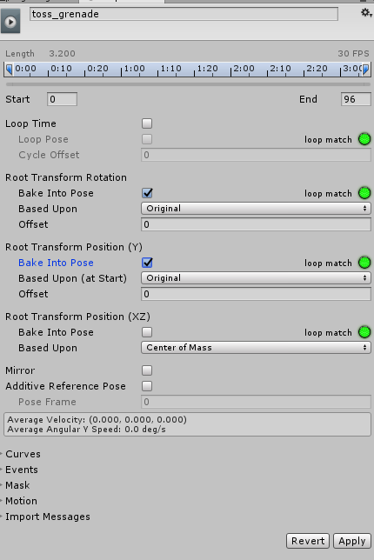
Mixing animations with Layers and Masks
7. Now, activate the Animations section.
Select the toss_grenade clip (from the Clips list),
click on the button Clamp Range to adjust the timeline, and
leave the Loop Time and Loop Pose options unchecked.
Under Root Transform Rotation,
check Bake Into Pose, and
select Baked Upon (at Start) | Original.
Under Root Transform Position (Y),
check Bake Into Pose, and
select Baked Upon (at Start) | Original).
Under Root Transform Position (XZ),
leave Bake Into Pose unchecked.
Click on Apply to confirm the changes.

Slide 63
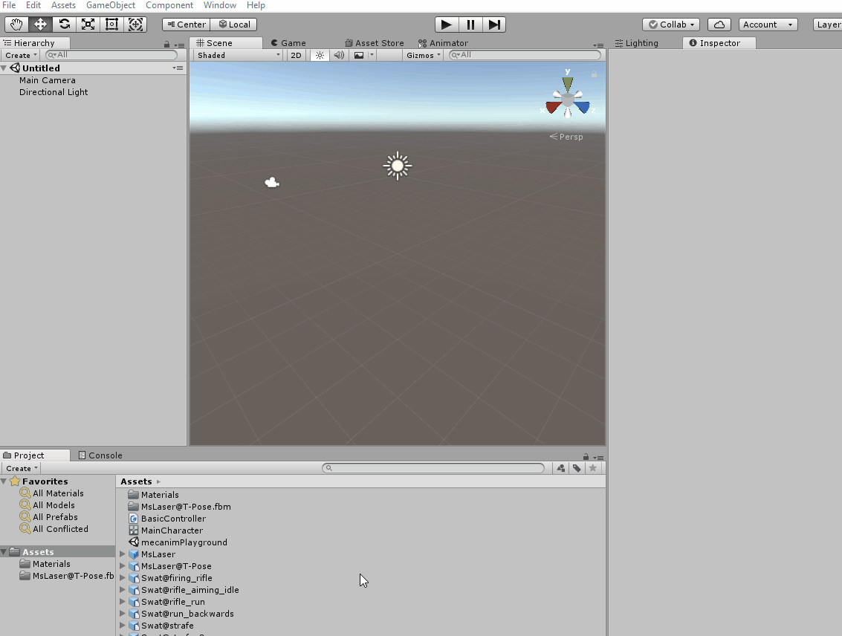
Mixing animations with Layers and Masks
8. Let's create a Mask.
From the Project view,
click on the Create button and
add an Avatar Mask to the project.
Name it as BodyMask.
9. Select the BodyMask tab and, in the Inspector view,
expand the Humanoid section to
unselect the character's legs, base, and IK spots, turning their outline red.

Slide 64
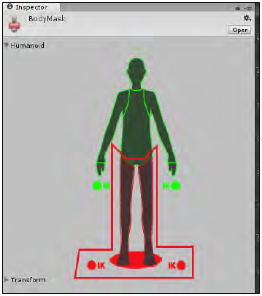

Slide 65
Mixing animations with Layers and Masks
10. From the Hierarchy view,
select the MsLaser character.
Then, from the Animator component in the Inspector view,
double-click on the MainCharacter controller to open it.
11. In the Animator view,
create a new layer by clicking on the + sign at the top-left Layers tab, above the Base Layer.
12. Name the new layer as UpperBody and click on the gear icon for the settings.
Then, change its Weight to 1, and
select the BodyMask in the Mask slot.
Also, change Blending to Additive.

Slide 66
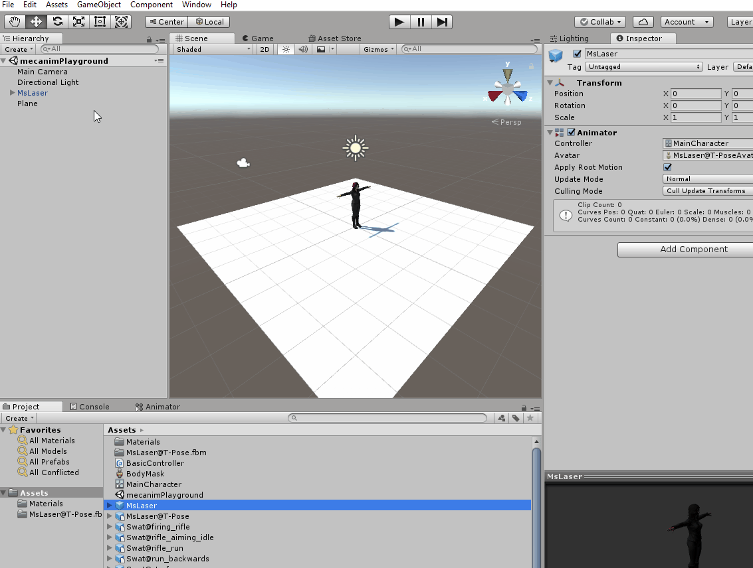
Mixing animations with Layers and Masks

Slide 67
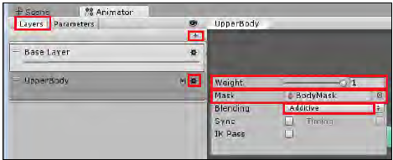
Mixing animations with Layers and Masks

Slide 68
Mixing animations with Layers and Masks
13. Now, in the Animator view, with the UpperBody layer selected,
create three new empty states
(by right-clicking on the gridded area and navigating to, from the menu, Create State | Empty).
Name the default (orange) state null, and the other two as Fire and Grenade.
14. Now, access the Parameters tab and
add two new parameters of the Boolean type:
Fire and Grenade.

Slide 69
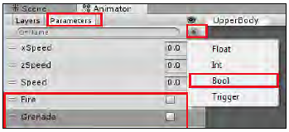
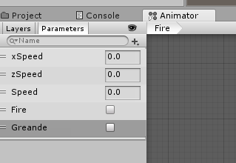
Mixing animations with Layers and Masks

Slide 70


Mixing animations with Layers and Masks
15. Select the Fire state and, in the Inspector view,
add the firing_rifle animation clip to the Motion field.

Slide 71

Mixing animations with Layers and Masks
16. Now,
select the Grenade state and, in the Inspector view,
add the toss_grenade animation clip to the Motion field.
17. Right-click on the null state box and,
from the menu,
select Make Transition.
Then, drag the white arrow onto the Fire box.

Slide 72

Mixing animations with Layers and Masks
18. Select the arrow (it will turn blue).
From the Inspector view,
uncheck the Has Exit Time option.
Then, access the Conditions list,
click on the + sign to add a new condition, and
set it as Fire and true.

Slide 73

Mixing animations with Layers and Masks

Slide 74

Mixing animations with Layers and Masks
19. Now,
make a transition from null to Grenade.
Select the arrow (it will turn blue).
From the Inspector view,
uncheck the Has Exit Time option.
Then, access the Conditions list,
click on the + sign to add a new condition, and
set it as Grenade and true.

Slide 75


Mixing animations with Layers and Masks
20. Now,
create transitions from Fire to null, and
create transitions from Grenade to null.
Then, select the arrow that goes from Fire to null and, in the Conditions box,
select the Fire and false options.
Leave the Has Exit Time option checked.
21. Finally,
select the arrow that goes from Grenade to null.
In the Conditions box,
select the options Grenade, false.
Leave the Has Exit Time option checked.

Slide 76

Mixing animations with Layers and Masks

Slide 77

Mixing animations with Layers and Masks
22. From the Hierarchy view,
select the MsLaser character.
Locate, in the Inspector view, the Basic Controller component and open its script.
23. Immediately before the end of the Update() function,
add the following code:
if(Input.GetKeyDown(KeyCode.F)){
anim.SetBool("Grenade", true);
} else {
anim.SetBool("Grenade", false);
}
if(Input.GetButtonDown("Fire1")){
anim.SetBool("Fire", true);
}
if(Input.GetButtonUp("Fire1")){
anim.SetBool("Fire", false);
}

Slide 78
Mixing animations with Layers and Masks
24. Save the script and play your scene.
You will be able to trigger the firing_rifle and toss_grenade animations by clicking on the fire button and pressing the F key.
Observe how the character's legs still respond to the Move animation state.

Slide 79
Submit the finished projects

Slide 80
Submit the finished projects
Submit the .package file for each mini project to dropbox link
Until tonight, 23:00 Korean time

